Slide 1

Implementing Project Management using Scrum
Scrum
Scrum an agile project management framework

Slide 2
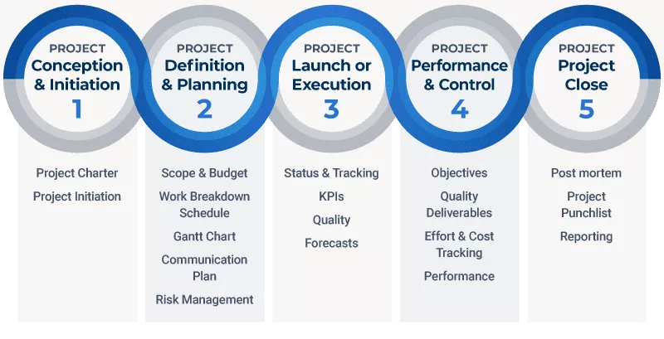
Project Management Cycle

Slide 3
Traditional PM versus Scrum Methods
Traditional PM Approach
Concentrates on thorough, upfront planning of the entire project.
Requires a high degree of predictions to be effective.
Traditional project management focuses on creating a fixed scope, cost and schedule for a project
Scrum Project Management (Agile PM)
Relies on incremental, iterative development cycles to be completed less-predictable projects.
Is ideal for exploratory projects in which requirements need to be discovered and new technology tested.
Focuses on active collaboration between the project team and the customer representatives.
Scrum encourages iterative decision making based on real-time data.
Agile follows an iterative process where projects are divided into sprints of a shorter span. Unlike the traditional approach.
less time is spent on upfront planning and prioritization as agile is more flexible in changes and specifications developments

Slide 4
Traditional Project Management versus Scrum Methods
Traditional
Design up front
Fixed cost
Deliverables
Freeze design as early as possible
Low uncertainty
Avoid change
Low customer interaction
Conventional project teams
Agile
Continuous Design
Flexible cost
Features/Requirements
Freeze design as late as possible
High uncertainty
Embrace change
High customer interaction
Self-organized project teams

Slide 5
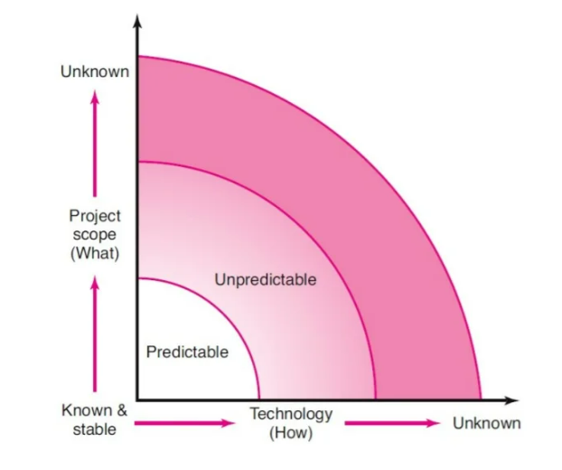
Project Uncertainty
Uncertainty comes in the Product Backlog is a risk for the schedule of a Scrum project. The problem is that the full scope of the release can be quite hard to estimate because the requirements are not well-know early on

Slide 6
Agile Project Management
Agile PM
-It is related to a rolling wave planning and scheduling project methodology
Uses iterations (“Time boxes”) to develop a worktable product that satisfies the customer and other key stakeholders
Stakeholders and customers review progress and re-evaluate priorities to ensure alignment with the customer needs and compony goals.
Adjustments are made and a different iterative cycle begins that subsumes the work of the previous iterations and adds new capabilities to the products.

Slide 7
Agile Project Management
Advantages of Agile PM
- Useful for developing critical breakthrough technology for defining essential features.
- Continuous integration, verification and validation of the evolving product.
- Frequent demonstration of progress to increase the likelihood that the end product will satisfy the customer needs.
- Early detection of defects and problems.

Slide 8
Agile Project Management
Limitations of Agile PM
- It requires active customer involvement and cooperation.
Its methods appear to work best on small projects that require only five-nine dedicated team members to complete the project.
It Does not satisfy the top managements needs for budget, scope and schedule control.
Its principle of self-organization and close collaboration can be incomplete with corporate cultures.

Slide 9
Agile Project Management Demonstration
Azure Devops Link- https://dev.azure.com/ShreyasMahendra
Project Integration Management- Project Charter
Project Scope Management
Project Schedule Management
Project Quality Management
Project Resource Management
Project Communication Management

Slide 10
Project Cost and Procurement Management Demonstration

Slide 11
Project Stakeholder Management Demonstration

Slide 12
Project Risk Management Demonstration

Slide 13
Project Closure Report

Slide 14
Thank You
Notes:
Picture : https://unsplash.com/photos/25CbufPYkZs

